Slide 1
Product/Service Monitoring System
Real-Time Twitter Sentiment Analysis
Sung Bae

Slide 2

The Importance
of
Communication
“Our beliefs and perceptions of reality, and the choices we make, are largely conditioned on how others see and evaluate the world”
- Bing Liu , University of Illinois, Chicago
Notes:
camilo jimenez
https://unsplash.com/photos/qZenO_gQ7QA
https://www.mobilecon2012.com/the-evolution-of-communication-through-the-centuries/

Slide 3

Twitter
145 million daily users
22% of Americans are on Twitter
500 million tweets sent each day
65.8% of US companies use Twitter for marketing
80% of Twitter users have mentioned a brand in a tweet
77% of Twitter users feel more positive when their tweet has been replied to.
Notes:
https://unsplash.com/photos/ulRlAm1ITMU

Slide 4

Goals
Create a dashboard that can
[1] stream tweets with filters so that we listen to relevant key words and phrases
[2] effectively classify tweets into negative, neutral, and
positive sentiments
[3] Flag the strongly negative tweets so they can be dealt with if necessary

Slide 5
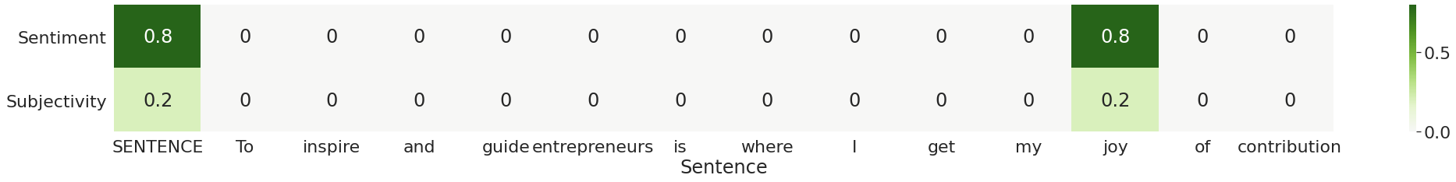
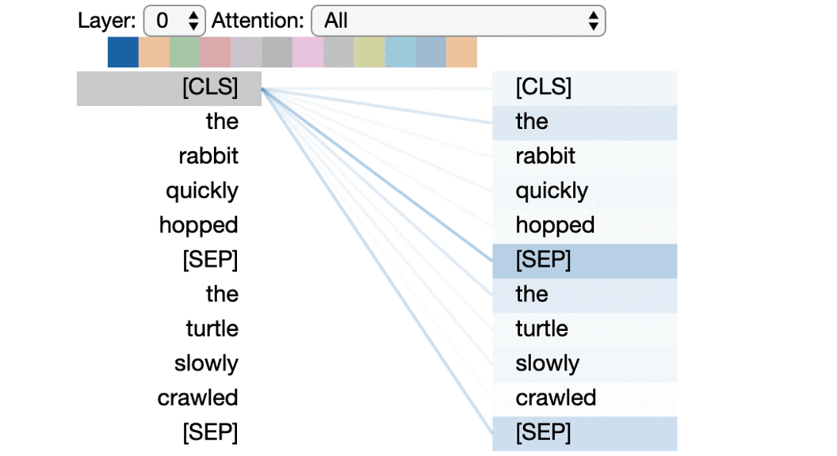
Models: TextBlob vs. BERT

Slide 6
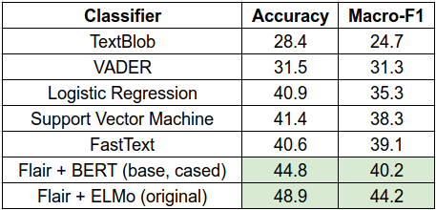
Models: TextBlob vs. BERT
Notes:
https://heartbeat.fritz.ai/evaluating-unsupervised-sentiment-analysis-tools-using-labeled-data-8d4bb1336cee?gi=4c7664a4537e

Slide 7
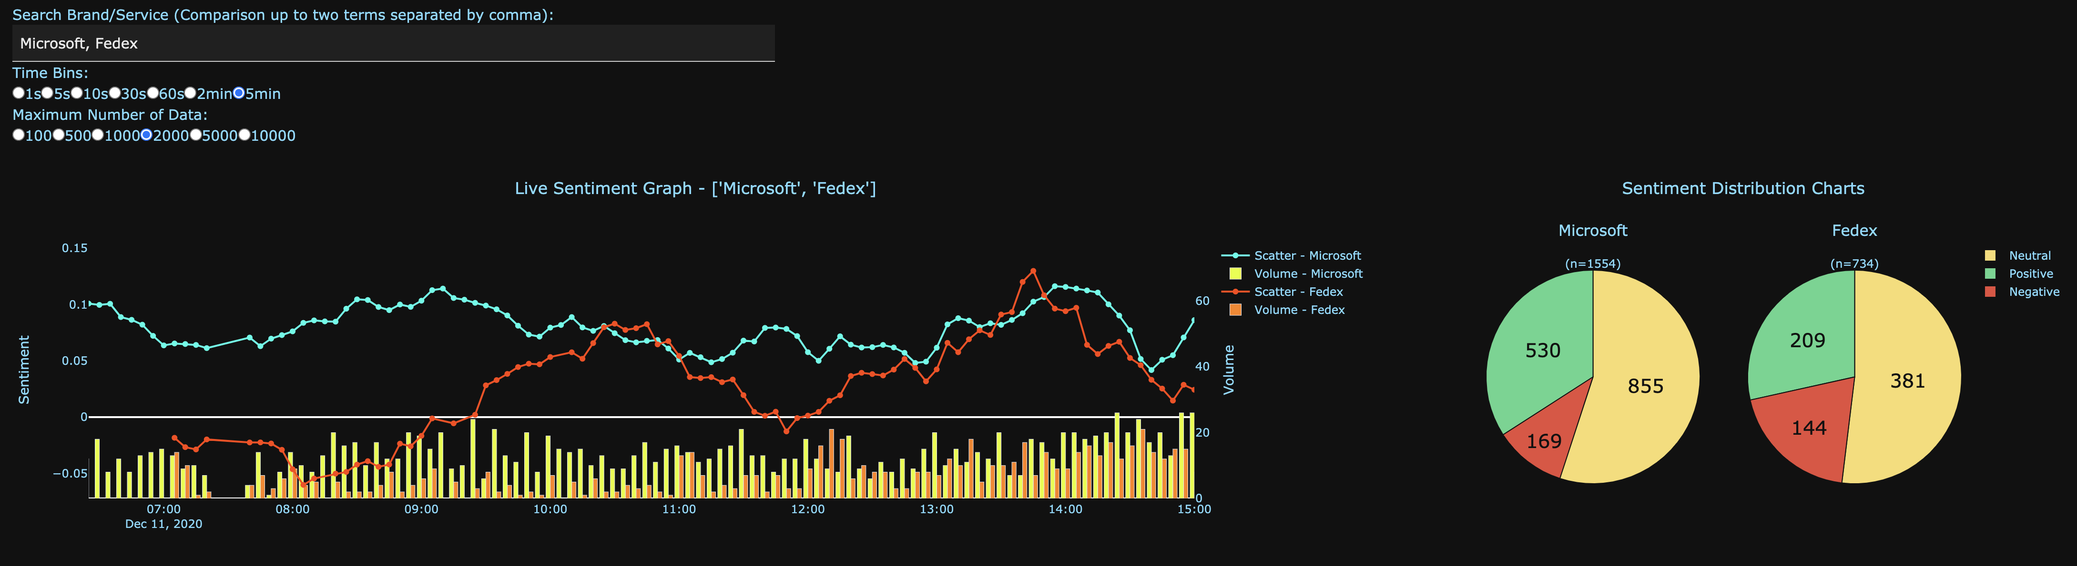
Dashboard
- Keywords to look for
(Up to two comparisons!)
- Change the number of data displayed in the graph
Sentiment distribution
Real-time moving average sentiment values.
Number of tweets per period of time.

Slide 8
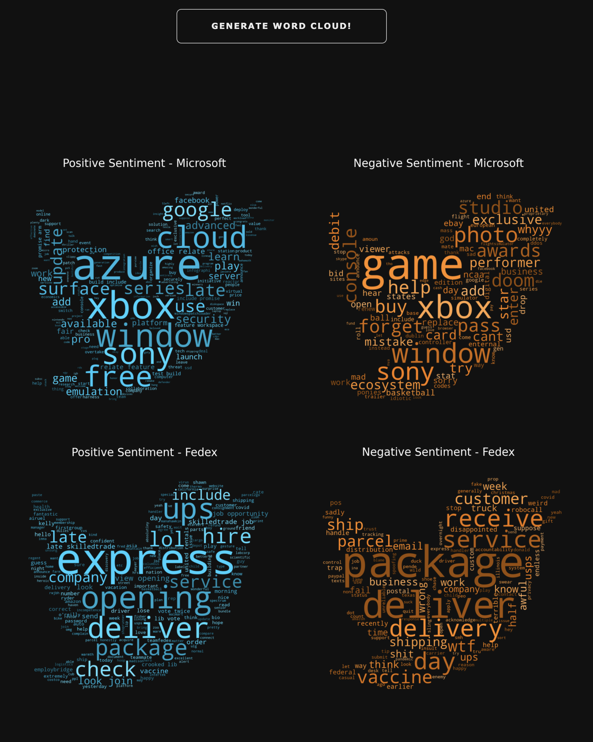
Dashboard
- Press this button to generate
word clouds associated with the keywords
- Visualize what words are used frequently with your service/product
- Visualize trends associate with your service/product or other competitors
- Further analysis can be done

Slide 9
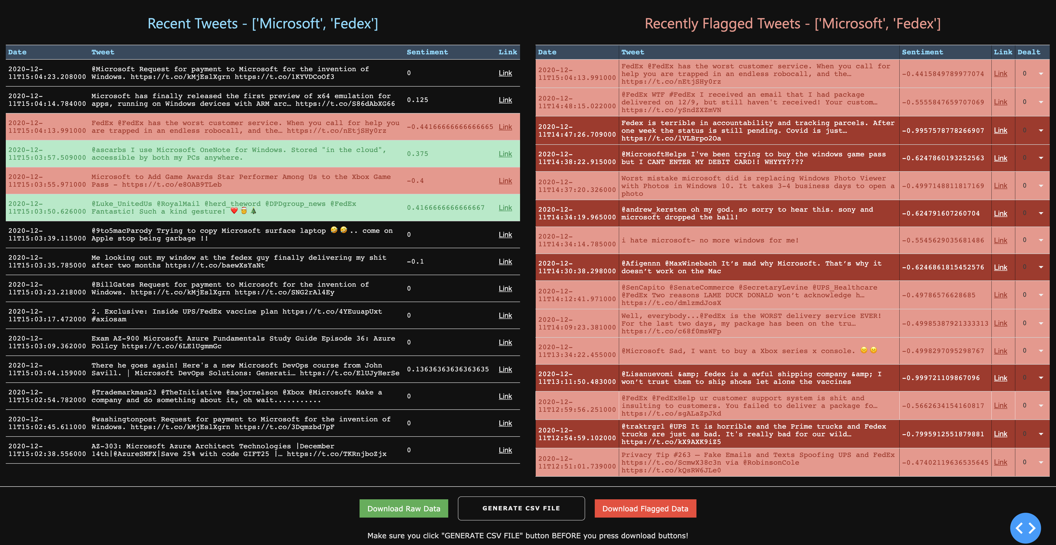
Dashboard
Live update of flagged tweets.
These flagged tweets are confirmed by BERT model which has 83% accuracy.
Live update of tweets.
Predicted by TextBlob Model which has low accuracy but high efficiency!
Make sure you press “GENERATE CSV FILE” to prepare “CSV” files for further analysis!

Slide 10
Recommendations 1 – Use of data
- Even though Textblob isn’t the best model in terms of accuracy, the dashboard tokenizes (cleans up) tweets that can be later used for further analysis

Slide 11
Recommendations 2 – Customer Service
- Due to high efficiency that TextBlob has along with BERT model which has high accuracy, the dashboard does well in finding tweets that are strongly negative. By resolving or dealing with these negative feedbacks from

Slide 12
Future Direction
1. Database structure
- As the database size increases, it might get too much for sqlite3 to handle. So, we want to separate database into parts so only when a large number of data is requested, we can combine or join smaller databases.
2. Reply feature
- It would be nice if we could add a feature where you could reply to any of tweets shown in the dashboard without going to twitter page.
3. Multiple keywords
- It would be nice if multiple keywords can be analyzed and followed at a given time.
4. Table Editing Mode
- Modify flagged tweets in the dashboard so that a user can classify flagged tweets as 'resolved', 'false negative', or 'other' for further customer service / data analysis.
5. Further analysis on both positive and negative tweets
- Find any correlation between tweet trends with how the company is doing to help with future direction of a company.

Slide 13
Thank you for listening

Slide 14
Appendix

Slide 15
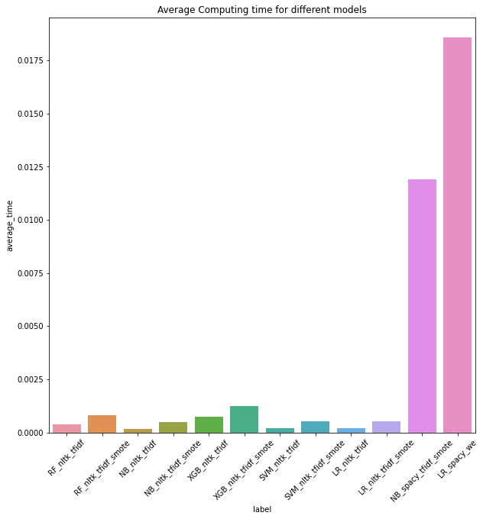
Average Computing Time

